Slide 1
This is the Name of the Webcast
Sales Management Association Webcast
Calibri Light 18 pt. bold
Constantia 48 pt.
13 October 2016
Calibri Light 14 pt
Bob Kelly
Chairman Sales Management Association rjkelly@salesmanagement.org
Some Guy
Vice President Marketing
Random Company lsguy@random.com
Some Lady
Chief Executive Officer
Anyco slady@anyco.com
All Presenter info is Calibri 18 pt. with the persons name Bold

Slide 2
15 – 17 OCTOBER 2018 ATLANTA

Slide 3
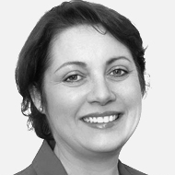
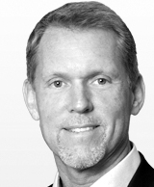
Today’s Speakers [Add alpha by last name, left to right]
Constantia 32 pt.
Some Lady
Bob Kelly
Guy Somers
Vice President Marketing
Chairman
Chief Executive Officer
Anyco
Sales Management Association
Whatco
All Presenter info is Calibri Light 18 pt. with the persons name Bold
slady@anyco.com
rjkelly@salesmanagement.org
someguy@whatco.com

Slide 4
This is the Name of the Webcast
Sales Management Association Webcast
13 October 2016
This is the same as the first slide.
Bob Kelly
Chairman Sales Management Association rjkelly@salesmanagement.org
Some Guy
Vice President Marketing
Random Company lsguy@random.com
Some Lady
Chief Executive Officer
Anyco slady@anyco.com

Slide 5
Slide title
Here is some text in a list of bullet points
Some more text in a second bullet point

Slide 6
This is a section divider slide that has some text here

Slide 7
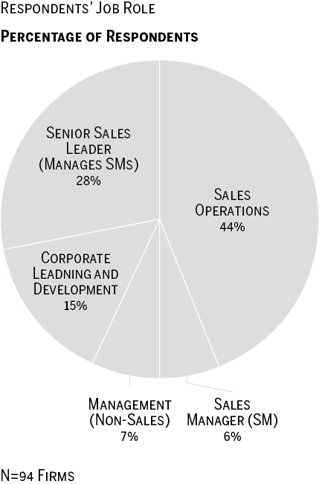
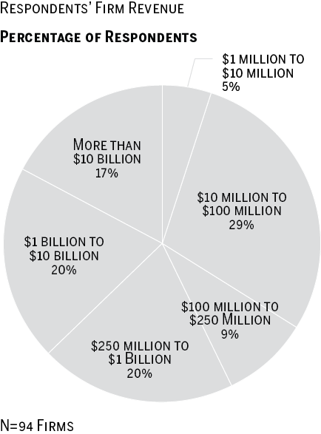
Another Slide Title With Some Sample Charts

Slide 8
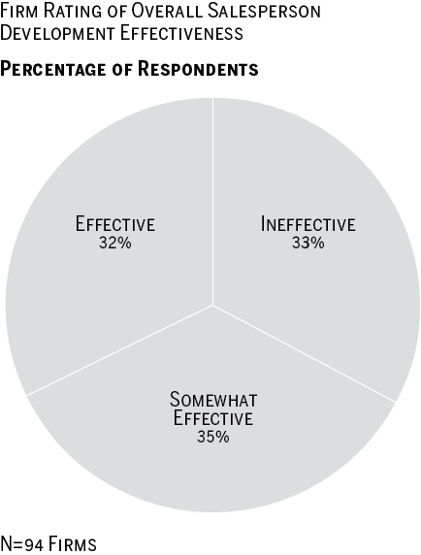
Training Effectiveness
This is a headline that is put next to a single chart

Slide 9
Another Headline Slide. OK to Ditch This Heading
“So here’s another thing. Fifty-percent of people say they are concerned about hiscupuquit.”

Slide 10
A Table It’s a Wide One
Sales Stages | Prospecting | Qualification | Needs Analysis | Proposal | Negotiation | Closed/ Won
Sales Process Gates | BANT/ ANUM/ MEDDIC Inbound/ Outbound WYWYN | Pre Discovery Post Meeting Follow up Summary No Show | Confirmation of requirements Sequence of Events | Initial pricing discussion | Negotiation summary | Intro email to AM/ CSM
Internal & External Content | eBooks Info graphics/videos/ blog Analyst Reports | Sales Pitch Deck Demo Materials | ROI calculator Product Data Sheet Action Plan | Pricing Sheet Proposal RFP | Onboarding/ Implementation Plan | Welcome Kit
Objections, Competitive, Deal Plays/ Strategy, Product Marketing, Case Studies, Industry Specific News, Field Events

Slide 11
A Simpler Table
Prep ▶ | Map ▶ | Craft ▶ | Executive ▶
Identify Internal Stakeholders & Which Audiences You Support Assess Your Sales Playbook, Process, Methodology, Messaging & Content | Map & Organize into the digital playbook framework | Establish team of collaborators responsible for crafting sales messaging and content Proactively harvest and package content/ messaging from top performers. | Recommend messaging/ content for every stage of the sales process embedded & actionable in daily workflow. Measure

Slide 12
How Does Training Become More Nimble?
This is a question. It appears on a slide like this when we know we’ll ask it in advance (also used in post production for audience-generated questions)

Slide 13
Your Questions [add panelists left to right by last name]
Some Lady
Bob Kelly
Bob Sanders
Vice President Marketing
Chairman
Chief Executive Officer
Ladyco
Sales Management Association
AXIOM Sales Force Development
somelady@ladyco.comm
rjkelly@salesmanagement.org
rjkelly@salesmanagement.org

Slide 15
Thank You

Slide 16
An audience generated question comes after the Q&A slide, added after the webcast

